Slide 1
Types of Network
Architecture

Slide 2
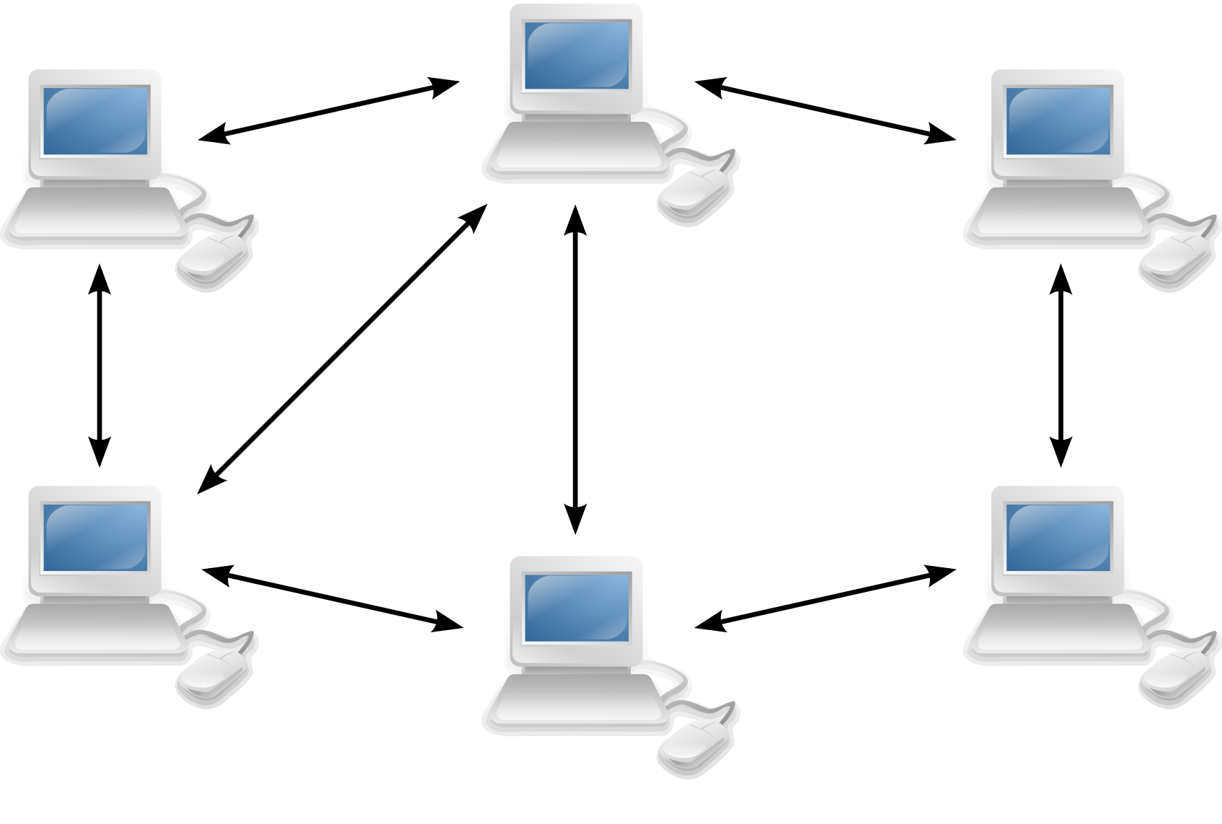
Peer to Peer Architecture
In peer-to-peer networking there are no dedicated servers or hierarchy among the computers. All of the computers are equal and therefore known as peers. Normally each computer serves as Client/Server and there is no one assigned to be an administrator responsible for the entire network.

Slide 3
Peer to Peer Architecture
Peer to peer is a type of architecture in which nodes are interconnected with each other and share resources with each other without the central controlling server.
P2P system allows us to construct such a distributed system or a application in which all resources and data is contributed by the hosts over the network.
P2P system allows us to sharing of data at very large scale without the use of any server whose job is to manage the scaling it means that scaling of data can be done without a server.
P2P are used in File-sharing, web-caching and providing information to user. Bittorrent is a examples of P2P applications which use P2P architecture.

Slide 4
Advantages of Peer to Peer
It is easy to install.
All resources are shared by all nodes with each other without a server.
Central dependency is eliminated.
It is more reliable.
Cost of building and maintaining this p2p network is less as compared to other network.

Slide 5
Disadvantages of Peer to Peer
As we no there is not central server so that network cannot be administrated for example we cannot filter the files being shared by the nodes with each other.
Security is an other issue in this network as malware can easily be transmitted across the network.
Because of no centralized server we cannot make a backup of system every node has to make backup of its own data in his system.
Transferring of sensitive data through the p2p is not recommended.

Slide 6
What is a Client?
Clients are PCs or workstations on which users run applications. Clients rely on servers for resources, such as files, devices, and even processing power. Another type of network architecture is known as a peer-to-peer architecture because each node has equivalent responsibilities
Note: A client is computer system, which act like a service requester in a Network

Slide 7
What is a Server?
Servers are powerful computers or processes dedicated to managing disk drives (fileservers), printers (print servers), or network traffic (network servers ).
Note: A Server is a powerful Computer, which provide services to their clients. It act like a Service Provider.

Slide 8

Client-server Architecture
The term Client/server refers to the concept of sharing the work involved in processing data between the client computer and the most powerful server computer.

Slide 9
Client-Server Architecture
The application is modeled as a set of services that are provided by servers and a set of clients that use these services.
Clients know of servers but servers need not know of clients.
Clients and servers are logical processes.

Slide 10
Types of Client-Server Architecture
2-tier:
The three application layers are mapped onto two computer systems which are the client and the server
Client can be
Thin client or
Fat client
3-tier:
The three application layers are mapped onto three logically separate processes that executes on different processors

Slide 11
What is Fat & Thin Client
A fat client (also called heavy, rich or thick client) is a computer (client) in client server architecture or networks that typically provides rich functionality independent of the central server
Example: SMTP, FTP, DNS Server
A thin client (sometimes also called a lean, zero or slim client) is a computer or a program or an application that depends heavily on another computer (its server) to fulfill its computational roles.
Example: MS Outlook, Remote Desktop

Slide 12
3-Tier Architecture
Each of the application layers may execute on a separate processor.
Allows for better performance than a thin-client model and is simpler to manage than a fat-client model.
A more scalable architecture - as demands increase, extra servers can be added.

Slide 13
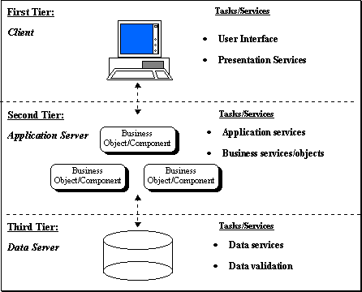
3-Tier Architecture

Slide 14
2-Tier Architecture
The Two-tier architecture is divided into two parts:
Client Application (Client Tier)
Database (Data Tier)
For e.g.: On client application side the code is written for saving the data in the SQL server database. Client sends the request to server and it process the request & send back with data. The main problem of two tier architecture is the server cannot respond multiple request same time, as a result it cause a data integrity issue.
Advantages:
Easy to maintain and modification is bit easy
Communication is faster
Disadvantages:
In two tier architecture application performance will be degrade upon increasing the users.
Cost-ineffective

Slide 15
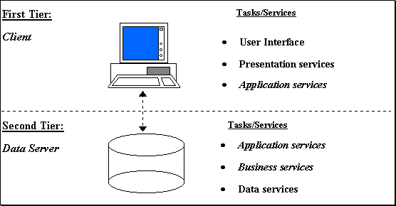
2-Tier Architecture

Slide 16
Advantage of Client-Server Architecture
1) Centralization : In client server network architecture there is a centralized control. Servers help in administering the whole set-up and also accessing rights and allocating resource is done by Servers.
2) Proper Management : Since all the files are stored at the same place management of files becomes easy making it easier to find files.
3) Back-up and Recovery possible : Making a back-up of all the data is easy as the data is stored on server. Suppose there’s some break-down and data is lost, it can be recovered easily and efficiently.
4) Upgradation and Scalability in Client-server set-up : If you want to make changes you will need to simply upgrade the server. Additionally you can add new resources and systems by making necessary changes in server.
5) Accessibility : From various platforms in the network, server can be accessed remotely.
6) Security : Rules defining security and access rights can be defined at the time of set-up of server.
7) Servers can play different roles for different clients.

Slide 17
Disadvantage of Client-Server Architecture
1. Congestion in Network: Too many requests from the clients may lead to congestion, which rarely takes place in P2P network. Overload can lead to breaking-down of servers. In peer-to-peer, the total bandwidth of the network increases as the number of peers increase.
2. Client-Server architecture is not as robust as a P2P and if the server fails, the whole network goes down. Also, if you are downloading a file from server and it gets abandoned due to some error, download stops altogether. However, if there would have been peers, they would have provided the broken parts of file.
3. Cost : It is very expensive to install and manage this type of computing.
4. You need professional IT people to maintain the servers and other technical details of network.

